Slide 1

MULTITHREADING IN JAVA
JAVA TRAINING
By Nachiket Juneja, Prakash Devnani

Slide 2
Agenda
Multiprogramming
Multitasking
Control flow of a program
Multithreading using classes
Multithreading using Runnable interface
Process vs Thread
States of a Thread
Life cycle of a Thread
Thread Priorities
Thread Class
Thread Methods : Constructor, sleep & interrupt
Thread: Daemon, join & yield
Synchronization

Slide 3
Agenda
Monitor
Multithreading using Monitor
Inter-Thread Communication

Slide 4
What’s Multiprogramming??
Running more than one program on a single computer/system
Running a single program at a time with a single user sub-optimally utilizes the the available resources.
Try and utilize the CPU and memory more efficiently.

Slide 5
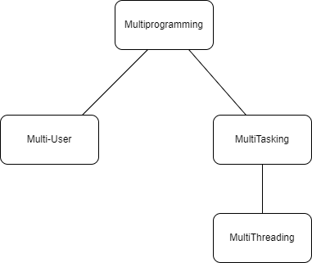
Forms of Multiprogramming
MULTI USER
More than one users will be using the machine simultaneously and will be running their own programs simultaneously.
MULTI TASKING
Single user running more than one program simultaneously.

Slide 6
Multithreading
Multithreading is a programming concept in which the application can create a small unit of tasks to execute in parallel
These small units of tasks are called threads.
A thread in Java is a lightweight sub-process, the smallest unit of processing, requiring fewer resources to create and share the process resources.
Notes:
If you are working on a computer, it runs multiple applications and allocates processing power to them. A simple program runs in sequence and the code statements execute one by one. This is a single-threaded application. But, if the programming language supports creating multiple threads and passes them to the operating system to run in parallel, it’s called multithreading.

Slide 7
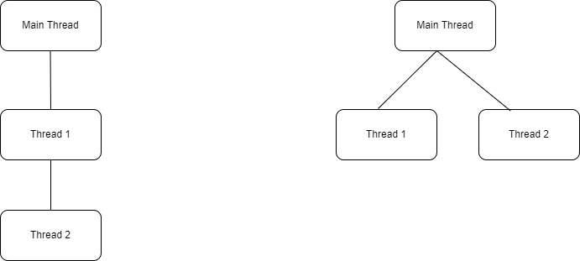
Multithreading
Multi Threaded Application
(Concurrent Flow)
Single Threaded Application (Sequential Flow)

Slide 8
Multithreading vs MultiProgramming
When we talk about multithreading, we don’t care if the machine has a 2-core processor or a 16-core processor.
Our work is to create a multithreaded application and let the OS handle the allocation and execution part.

Slide 9
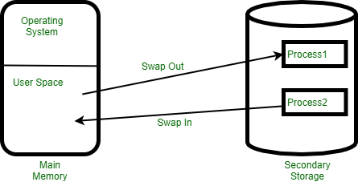
Multithreading vs MultiProgramming
Which one should we be using??
We’ll use Multithreading.
Threads use a shared memory area which helps to save memory
Content-switching between the threads is a bit faster than the process

Slide 10
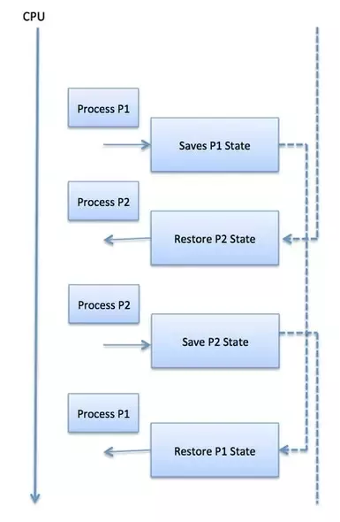
Context Switching

Slide 11
Advantages of Multithreading
It doesn't block the user because threads are independent and you can perform multiple operations at the same time.
Multithreading saves time as you can perform multiple operations together
Threads are independent, so it doesn't affect other threads if an exception occurs in a single thread.

Slide 12
Java Support for MultiThreading
Java supports multithreading through Thread class.
We can create multiple threads in our program and start them.
Java runtime will take care of creating machine-level instructions and work with OS to execute them in parallel.

Slide 13
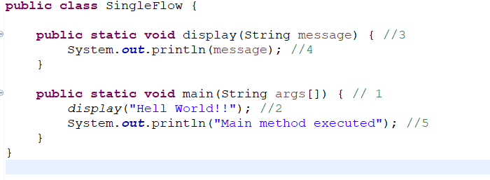
Control Flow of a Program

Slide 14
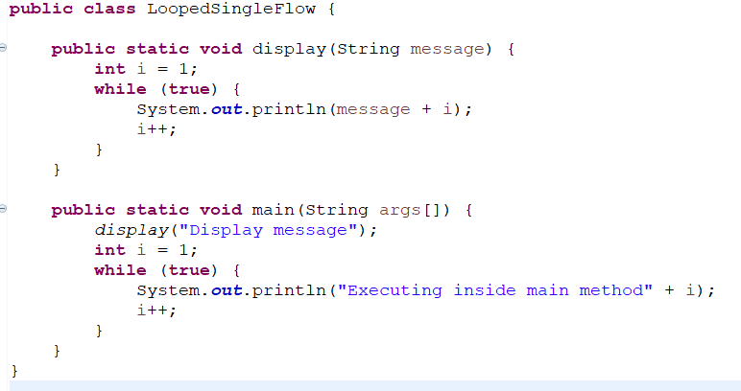
Control Flow of a Program

Slide 15
Implementing MultiThreading in Java
Thread Class
Runnable Interface
Mechanism present in the Thread class
Use Thread class if your existing class is not extending any other class
Use Runnable interface when your existing class is already extending some other class

Slide 16
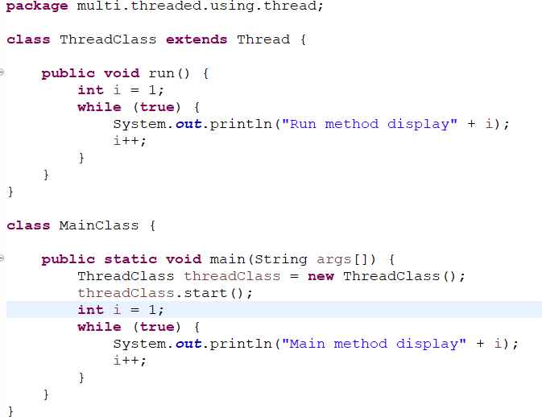
Using Thread Class

Slide 17
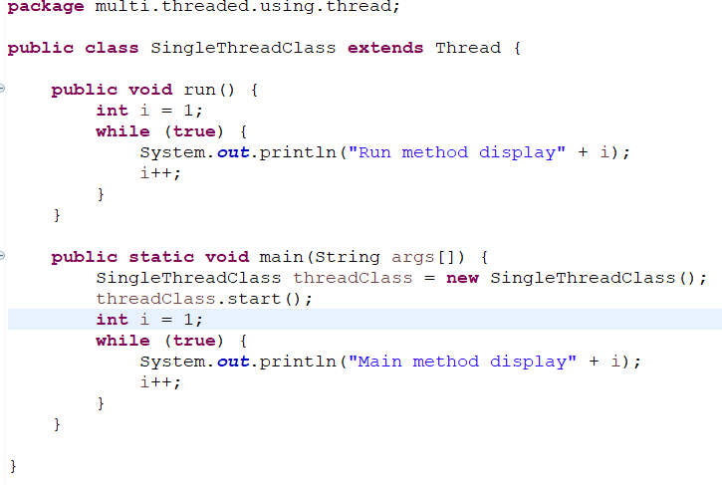
Using Thread Class

Slide 18
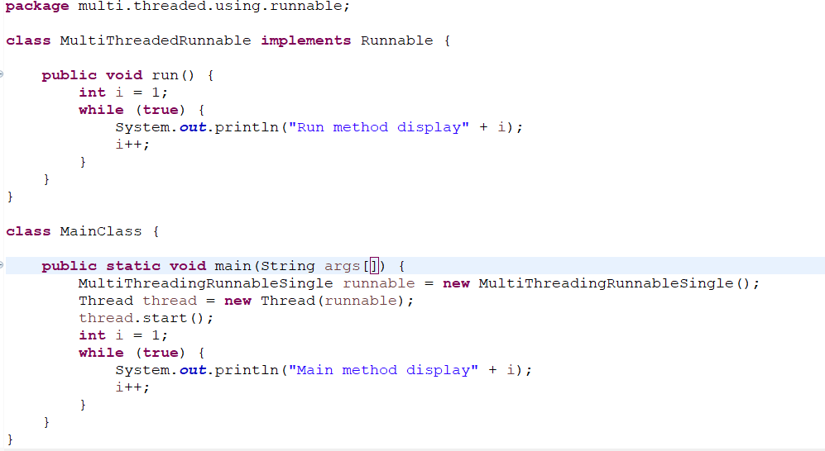
Using Runnable Interface

Slide 19
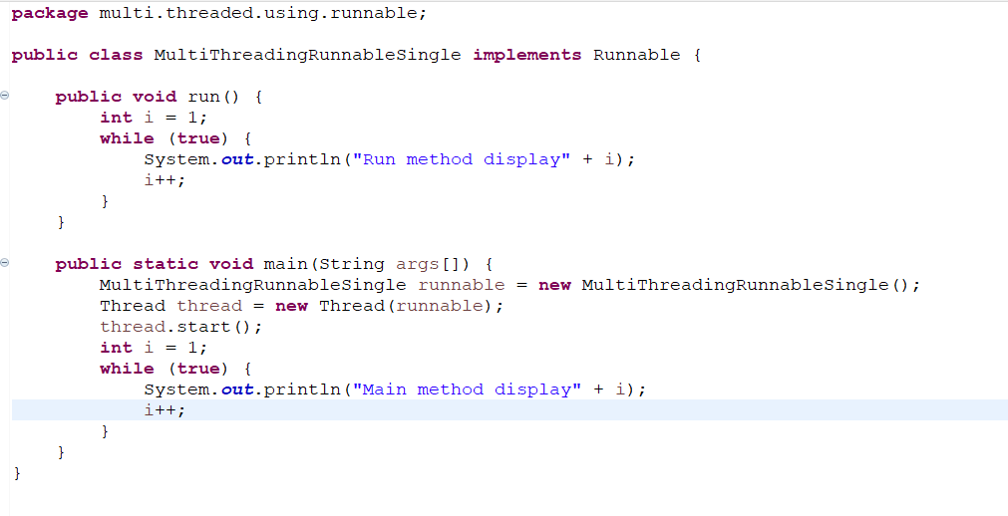
Using Runnable Interface

Slide 20
Process vs Thread
Parameters | Process | Thread
Definition | Any program in execution. | A segment of a process.
Context Switching | Takes more time. | Takes less time.
Efficiency in Communication | Less efficient. | More Efficient.
Multiprogramming | Can run multi-process. | A single process consists of multiple threads.
Data Sharing | Doesn’t share data with each other. | Shares data with each other.

Slide 21
States of a Thread
NEW - A thread that has not yet started is in this state.
RUNNABLE - A thread executing in the Java virtual machine is in this state.
BLOCKED - A thread that is blocked waiting for a monitor lock is in this state.
WAITING - A thread that is waiting indefinitely for another thread to perform a particular action is in this state.
TIMED_WAITING - A thread that is waiting for another thread to perform an action for up to a specified waiting time is in this state.
TERMINATED - A thread that has exited is in this state.

Slide 22
Life cycle of a Thead
I/O Request
start()
run()
New
Runnable
Running
Blocked
sleep()
End of Execution
notify()
wait()
Terminated
Waiting
Timed_Waiting

Slide 23
Thread Priorities
Priorities are represented by a number between 1 and 10.
Preemptive Scheduling: The thread scheduler schedules the threads according to their priority.
A Java programmer can also assign the priorities of a thread explicitly in a Java program.
public final int getPriority()
public final void setPriority(int newPriority)

Slide 24
Thread Class
The Java Virtual Machine allows an application to have multiple threads of execution running concurrently.
Threads with higher priority are executed in preference to threads with lower priority.
public class Thread
extends Object
implements Runnable

Slide 25
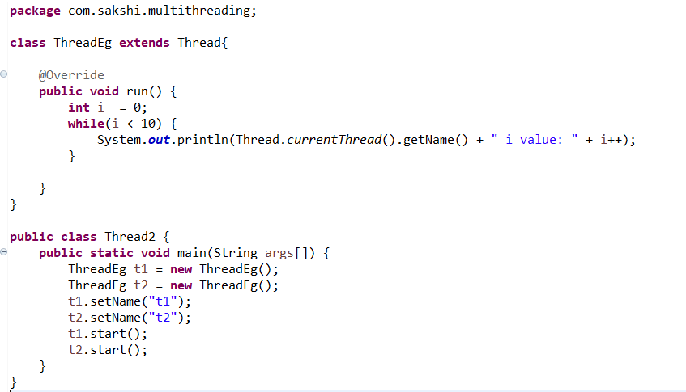
Thread Class

Slide 26
Thread Methods : Constructor,
sleep & interrupt
Thread Constructor
Thread()
Thread(Runnable target)
Thread(Runnable target, String name)
Thread(String name)
Thread(ThreadGroup group, Runnable target)
Thread(ThreadGroup group, Runnable target, String name)
Thread(ThreadGroup group, Runnable target, String name, long stackSize)
Thread(ThreadGroup group, String name)

Slide 27
Thread Methods : Constructor,
sleep & interrupt
Thread Methods
sleep()
join()
yield()
notify()
notifyAll()
wait()
setPriority()
setName()
isDaemon()
isAlive()
interrupt()
And many more…
You can find the link of official documentation of Java on Thread Methods:
https://docs.oracle.com/javase/7/docs/api/java/lang/Thread.html

Slide 28
Thread: Daemon, join & yield
yield()
The yield() basically means that the thread is not doing anything particularly important and if any other threads or processes need to be run, they should run. Otherwise, the current thread will continue to run.
join()
The join() method of a Thread instance is used to join the start of a thread’s execution to the end of another thread’s execution such that a thread does not start running until another thread ends.
Daemon
Daemon thread in Java is a low-priority thread that runs in the background to perform tasks such as garbage collection.

Slide 29
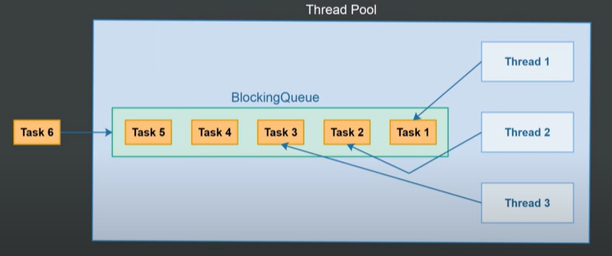
ThreadPool & ThreadPoolExecutor
Thread Pool
A collection of worker threads that efficiently execute asynchronous callbacks on behalf of the application.
Reduce the number of threads and provide management of the worker threads.

Slide 30
Important Terms
Resource Sharing
Critical Section
Mutual Exclusion
Locking / Mutex
Semaphore
Monitor
Race Condition
Inter-Thread Communication

Slide 31
Resource Sharing
Any object shared among threads and processes.
Objects like :
Code
Data

Slide 32
Critical Section
That part of the Thread which is trying to access a shared resource is called Critical Section.
Shared Object
THREAD A
<some code>......
……………………
……………………
……………………
……………………
……………………
……………………
……………………
Critical section

Slide 33
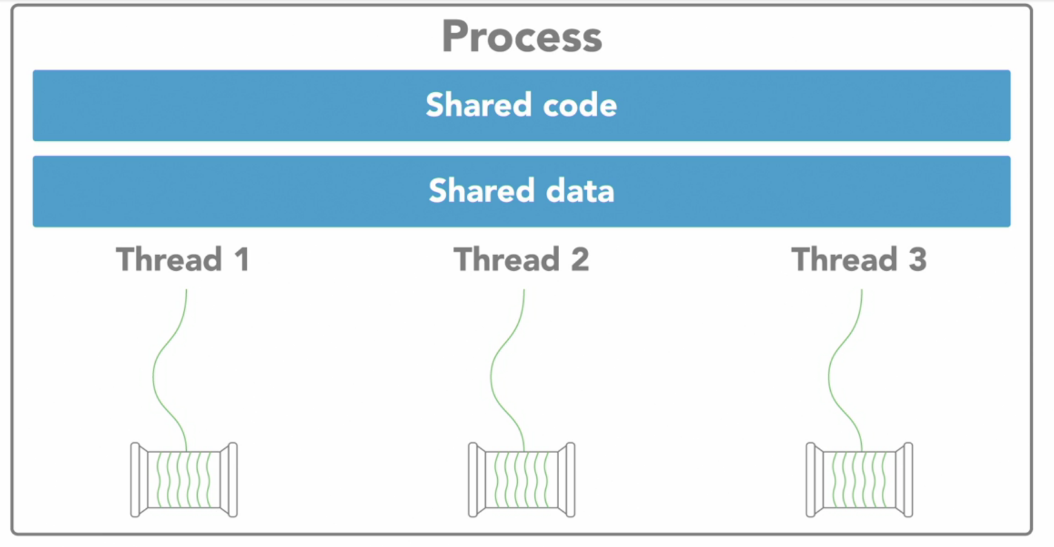
Mutual Exclusion
Allowing only one Thread to access shared object and preventing all other threads to access the same shared object at that time.

Slide 34
Locking / Mutex
Shared object
Only thread takes care to achieve mutual exclusion
THREAD A
………………….
………………….
………………….
Lock()
read() shared object
write() shared object
unlock()
…………………
…………………
…………………
………………….
THREAD B
………………….
………………….
………………….
Lock()
read() shared object
write() shared object
unlock()
…………………
…………………
…………………
………………….

Slide 35
Locking / Mutex
Is there any limitation/ issues with this ?
Consider this case…
Thread A and Thread B are in the queue ,and both the threads wants to access the same shared object .
First Thread A checks if the shared object is locked by any other thread, here it finds the shared object is not locked , and right before locking the shared object context switching occurs .
Now Thread B checks if the shared object is locked by any other thread, here it finds the shared object is not locked and it put a lock on the shared object and started accessing it .
Now If context switching again occurs ,Thread A will put a lock and start using shared object (Since before 1st context switching Thread A already checked if there is any lock on shared object ,so it does not checks again and just put a lock.
Here the mutual Exclusion is not achieved..

Slide 36
Semaphores
Here OS take care to achieve mutual exclusion.
We can also use semaphores to limit the number of concurrent threads accessing a specific resource.
Shared object
Operating System
Mutex , wait() , signal() , wait queue()
THREAD A
………………….
………………….
………………….
wait()
read() shared object
write() shared object
signal()
…………………
…………………
…………………
………………….
THREAD B
………………….
………………….
………………….
wait()
read() shared object
write() shared object
signal()
…………………
…………………
…………………
………………….

Slide 37
Semaphores
Let’s talk about the same case we discussed in locking section
Thread A and Thread B are in the queue ,and both the threads wants to access the same shared object .
First Thread A tries to access the shared object and right before locking the shared object context switching occurs .
Now Thread B checks if the shared object is locked by any other thread, here it finds the shared object is not locked and OS puts a lock on the shared object and thread starts accessing it .
Now If context switching again occurs ,Thread A will try to access the shared object ,OS will pull Thread A to wait queue ,will only allow Thread A to again access the Shared object when it gets signal that Thread B has finished
Here the mutual Exclusion

Slide 38
Monitor
Here shared object takes care to achieve mutual exclusion
We don’t have to maintain any queue or write any logic to achieve mutual exclusion , we just have to use the “ Synchronization” and JVM will take care of everything
Shared Object
Mutex , wait() , signal() , wait queue()
THREAD A
………………….
………………….
………………….
read() shared object
write() shared object
…………………
…………………
…………………
………………….
THREAD B
………………….
………………….
………………….
read() shared object
write() shared object
…………………
…………………
…………………
………………….

Slide 39
Race Condition
A condition in which the critical section (a part of the program where shared object is accessed) is concurrently executed by two or more threads. It leads to incorrect behavior of a program.

Slide 40
Inter-Thread Communication
The communication among threads to access the same shared object.
So We can say that..
It is a mechanism in which a thread is paused running in its critical section and another thread is allowed to enter (or lock)
in the same critical section to be executed.It is implemented by following methods of Object class:
wait()
notify()
notifyAll()

Slide 41
Inter-Thread Communication
Shared Object
write
read
Accessing shared object
Accessing shared object
notify()
Thread A
Thread B
wait()
notify()
wait()

Slide 42
Synchronization
The capability to control the access of multiple threads to any shared resource.

Slide 43
Synchronization
In the Multithreading concept, multiple threads try to access the shared resources at a time to produce inconsistent results.
The synchronization is necessary for reliable communication between threads.
Shared resource
[code to print string character by character]
OUTPUT
HEWLORLOLD or
HELLWORLDO or
HEWORLLLOD or
WOHELRLDLO or
WHOERLLLDO
…etc
THREAD A
“HELLO”
THREAD B
“WORLD”

Slide 44
Synchronization
With Synchronization , It will prevent interference of multiple Threads
Shared resource
[code to print string character by character]
OUTPUT
HELLOWORLD
THREAD A
“HELLO”
THREAD B
“WORLD”

Slide 45
Synchronization
WHY WE USE SYNCHRONIZATION ?
Synchronization helps in preventing thread interference.
Synchronization helps to prevent concurrency problems.

Slide 46
Thankyou

